Slide 1


DΔnamic δoil Properties (DSP) January 26, 2020 Olympia Train, PI 12 Jason Nemecek Dynamic Soil Properties (DSP) Product Owner National Soil Data Applications Scientist
Science-driven - defensible - actionable
January 2021

Slide 2
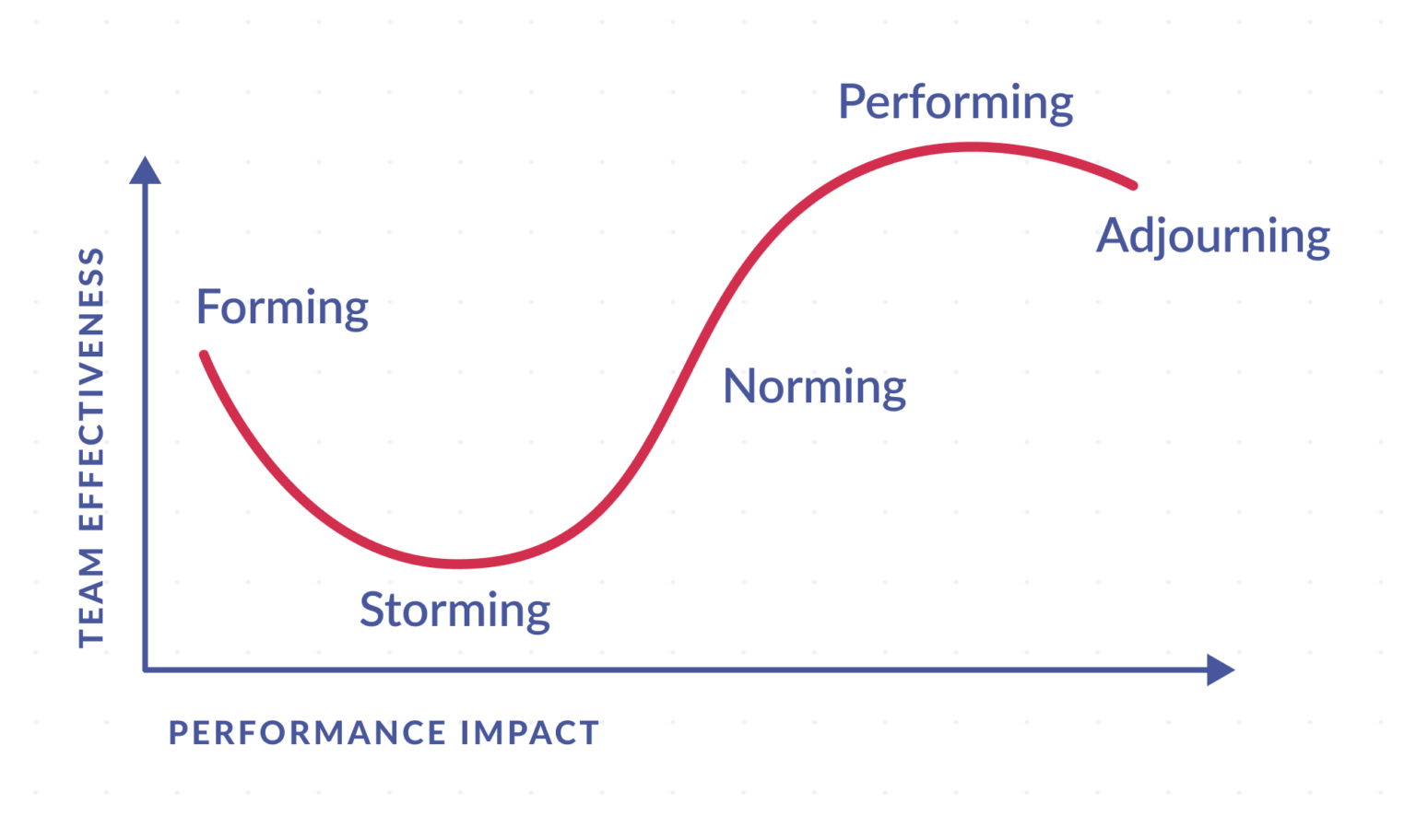
PI 0.5 – just barely kicking off
Where are we at?
Team was not fully formed
Scrum team has handled a lot of pivots during PI 12
Swarm work in 1st PI was very good.
Each member contributed to multiple word areas
We are here

Slide 3

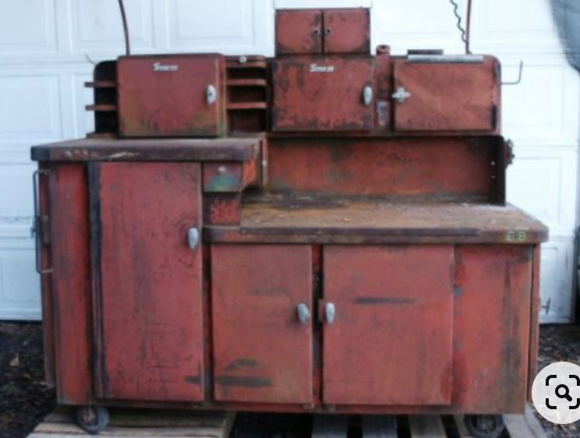
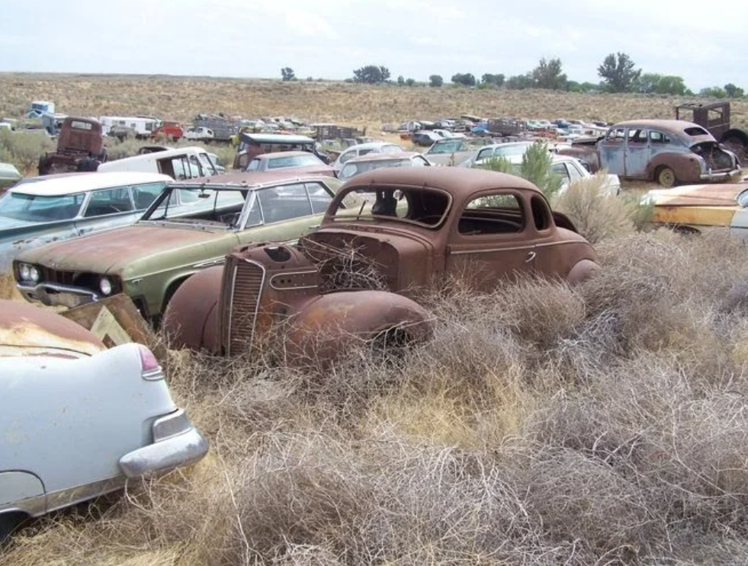
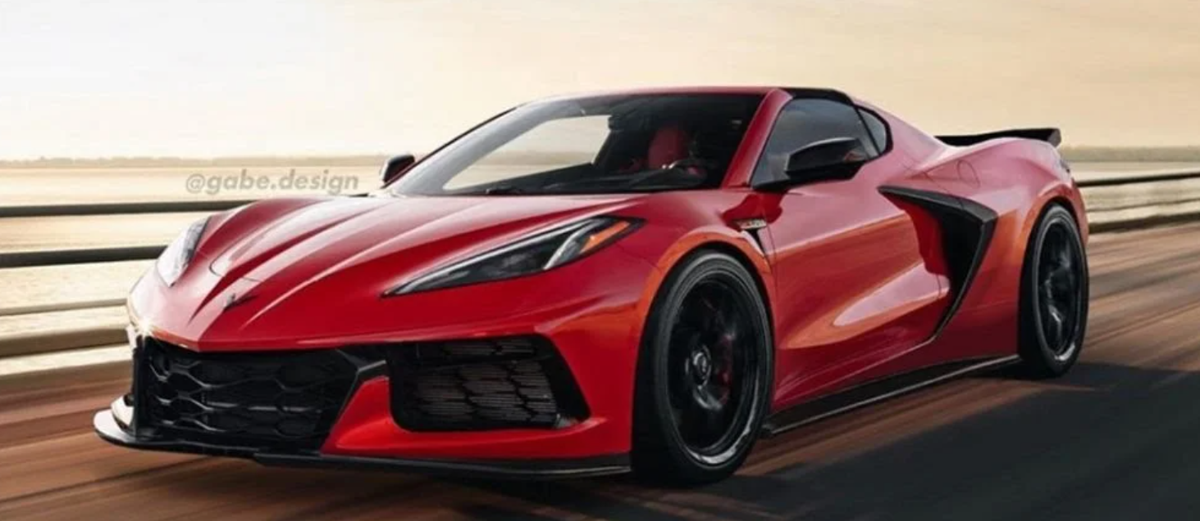
We established our design concept
High-end geospatial data science workbench
Versatile tools
Organized libraries for models and analytics
Skunkworks (Soil) Bench
future expansion?
Economists Bench
Water Bench
Carbon Bench

Slide 4
Strong progress
Accomplishments
NCSS development server resources in NITC
Draft architecture Analysis of Alternatives (AoA) was produced with near and long-term platforms and analytics tools
High confidence we have identified project processes, data library requirements, and analytic requirements for success
Initial identification of dependencies with CIG, CPD, and CART identified

Slide 5
Strong Progress
Accomplishments
Lifecycle requirements for authoritative data have been identified and draft process documented by architecture team
Good progress on datasets loaded into the DSP Hub
Identification and documentation of additional data sets has good progress
Data Maturity Management (DMM) efforts have started and include a starting a business glossary and a data dictionary
Confluence page is in good initial shape

Slide 6
Rough Spots – basic access and staff
Challenges
Over ½ the DSP Hub team didn’t have LincPass, privileged Account (p-Account), and Government laptops for over ½ of the program increment.
Still working through access rights on accounts and one scrum-team member does not have LincPass, p-Account, or Government laptop
The DSP team is missing a geospatial developer with Linux background. This has become a top-priority need.

Slide 7
Rough Spots – Process Challenges
Challenges
Some Requirements Management Section (RMS) work has been accomplished. We are now shifting from the current RMS waterfall method of completing their work to an Agile methodology.
The Service Strategy and Planning Branch (SSPB) did not start work on DSP Hub prior to Program Increment (PI) 12. Late in increment 12 we developed a coordinated plan to pursue further architectural requirements in an Agile methodology.
RMS and SSPB would have preferred to finish their work on DSP Hub prior to contractor work beginning

Slide 8
Rough Spots – Barriers/Dependencies
Challenges
EDAPT planning
New business analyst 2 weeks ago – Jira stories have been disjointed but improving
Scrum Master has 2nd scrum team duties on challenging NASIS modernization project
We anticipate needing to submit for an Authority To Operate (ATO) soon
Dependencies with other FPAC projects and systems need more planning and insight

Slide 9
Goal for next PI = achieve high-speed wobble
SAFe Agile – Relentless Improvement
Continue to clarify and enforce roles and responsibilities
Improve communication and meeting efficiency
Identify hand-off points in the assembly line
Right-size our Stories, Features, and Epics
Get the geospatial developer
Further clarify the needs and strategy for the data libraries, workbench, and any supporting processes or applications
Get a decision and plan on next steps for EDAPT exemption
Prepare proposal for additional funding by end of Feb

Slide 10
Next Steps Agile Approach
Fine-tune business and IT processes, standards, and roles to scale up
Soil Carbon outcomes
Soil Health SHAPE Interp
Formally launch Advanced Benefits Services by FY22
Currently in PI 0.5
Automate workflow
zRoles structure
Add data scientists
Next PI – learn and adapt, document draft processes and product requirements to scale up. Establish initial data libraries.

Slide 11
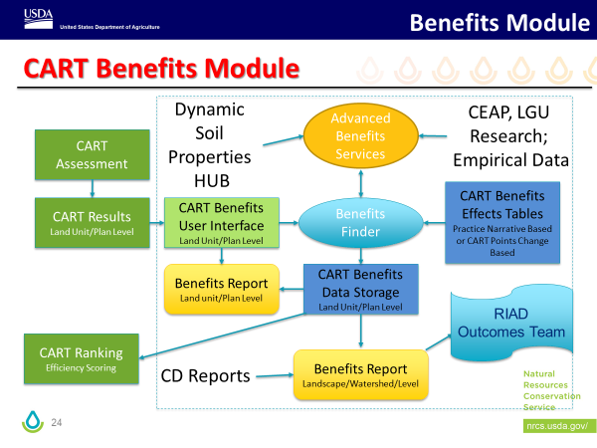
Program Outcomes/Environmental Benefits
DSP Hub as initial design for “Advanced Benefits Services”
Develop requirements for soil-related Environmental Benefits data development
Establish efficient workflow for cross-Deputy Area review process

Slide 12
Epics/Features – no additions to backlog yet
Top Priorities for next PI
Agile design work (“Fast fail” Agile design for SHAPE and COMET as initial products to learn on) | Epic or Feature (these still need work, but shown here for high-level view
 | Load all datasets required for the development of the SHAPE curves onto DEV server
 | Load all datasets required for the development of the COMET method onto DEV server
 | Explore and document a workflow process and standard operating procedure for the development of the COMET method carbon benefits
 | Explore and document workflow process and standard operating procedure for the development of the SHAPE curve

Slide 13
Epics/Features – no additions to backlog yet
Top Priorities for next PI
 | Epic or Feature (these still need work, but shown here for high-level view
Data Management Maturity/ Governance (Data management maturity is a core value of DSP Hub) | Establish the data standard for the Soil Health Database
 | Establish the data standard for COMET and carbon accounting
 | Develop an approval process and documentation for release of COMET-based carbon benefits
 | Develop a data model/system architecture for soil health data libraries including data management maturity
 | Develop a data model/system architecture for carbon accounting data libraries including data management maturity
 | Define what is needed for data management maturity in the long term solution.
 | Research and document Data Dictionary needs and best practices

Slide 14
Epics/Features – no additions to backlog yet
Top Priorities for next PI
 | Epic or Feature (these still need work, but shown here for high-level view
Agile AoA work (currently in partnership with TSPi and SSP providing analysis oversight – represents the needs to develop a fully functioning system) | Analysis of tools and platform needed to develop and document Soil Health Database and soil analytics products
 | Determine appropriate solutions for soil health data analytics and visualization
 | Determine tech stack/platform requirements for soil health data
 | Determine short-term and development server needs for the DSP Hub
 | Analysis of tools and platform needed to develop and document COMET-based method and soil carbon analytics products
 | Determine tech stack/platform requirements
 | Determine appropriate solutions for carbon analytics and visualization
 | Determine internal and external data provisioning/customers of carbon benefits data and options for delivery
 | Research and document user authentication and access control needs and the methods available to implement them.

Slide 15
Epics/Features – no additions to backlog yet
Top Priorities for next PI
 | Epic or Feature (these still need work, but shown here for high-level view
Automation Implementation | Develop a data ingestion method for Soil Laboratory Data coming in from CIG OFSHDT participants
 | Develop a data ingestion method for Soil Health Minimum Dataset for CIG On-Farm Soil Health Demonstration Trials
 | Develop a data ingestion method activity data (NPAD, ProTracts, CIG, others) for COMET
 | Automate the development of carbon estimates curves
 | Automate the development of SHAPE curves

Slide 16
Epics/Features – no additions to backlog yet
Top Priorities for next PI
 | Epic or Feature (these still need work, but shown here for high-level view
Peer-review/science based data products | Develop an approval process and documentation for release of SHAPE Curves
 | Develop a method that identifies authoritiative data and data products approved for public release
 | Determine internal and external data provisioning/customers of SHAPE curve and options for delivery
 | Establish a zRoles structure for DSP Hub to support data upload, processing, reviews, and approvals (may be some dependency on CIG Team #2?)
 | Develop an approval process and documentation for release of carbon

Slide 17
Epics/Features – no additions to backlog yet
Top Priorities for next PI
 | Epic or Feature (these still need work, but shown here for high-level view
Scaling up work | Identify and load additional high-priority datasets for the Soil Health Database (as identified by the customers)
 | Develop a prioritization method for new data sources and analytical products
 | Establish a workflow for development of DSP Hub analytics products
 | Identify and load additional high-priority datasets for soil carbon accounting (as identified by the customers)

